Slide 1

Introduction to Operating Systems CS/COE 1550
Spring 2020-2021
Sherif Khattab
ksm73@pitt.edu
(Some slides are from Silberschatz, Galvin and Gagne ©2013)

Slide 2
Announcements
Lab 0 and Lab 1 have been posted
Homework 1 will be posted this Friday
Recitations start this week
Tophat questions assigned as homework

Slide 3
Last lecture …
System call invocation is very expensive!
Don’t make unnecessary syscalls in your applications.
2
7
6
12
10
1
3
5
4
11
8
9

Slide 4
Muddiest points
The muddiest point in lecture for me came during discussion step 2 of system calls. My main question is this: Are all applications allowed to modify the value of EAx?
what is an interrupt
nested interrupts
The key differences between interrupt and syscalls
following the pc through the functions

Slide 5
Muddiest points
How the CPU knows where to look in the IDT table (in the example, what defines the keyboard as pointing to spot 1 in the IDT?) and how the IDT knows or determines the address of the function it returns to the PC register
Why the IDT seems to get passed by copy instead of by reference in lidt() in trap.c (maybe my C is just rusty, not sure)
IDT in CPU vs IDT in memory
switching between privileged and non privileged mode
How the EAX register is set
Is the IDT software or hardware?

Slide 6
System Call Parameter Passing
Three general methods used to pass parameters to the OS
Simplest: pass the parameters in registers
In some cases, may be more parameters than registers
Parameters stored in a block, or table, in memory, and address of block passed as a parameter in a register
This approach taken by Linux and Solaris
Parameters placed, or pushed, onto the stack by the program and popped off the stack by the operating system
Block and stack methods do not limit the number or length of parameters being passed

Slide 7
How to add a system call to an OS?

Slide 8
Xv6 Code Walkthrough
IDT table initialization
Syscall table
How a syscall is invoked
Syscall implementation
Parameter passing into a syscall
In Lab 1 you will add a system call to Xv6

Slide 9
Operating System Structure
General-purpose OS is very large program
Various ways to structure an OS:
Simple structure – MS-DOS
More complex – UNIX
Layered – an abstraction
Microkernel – Mach

Slide 10
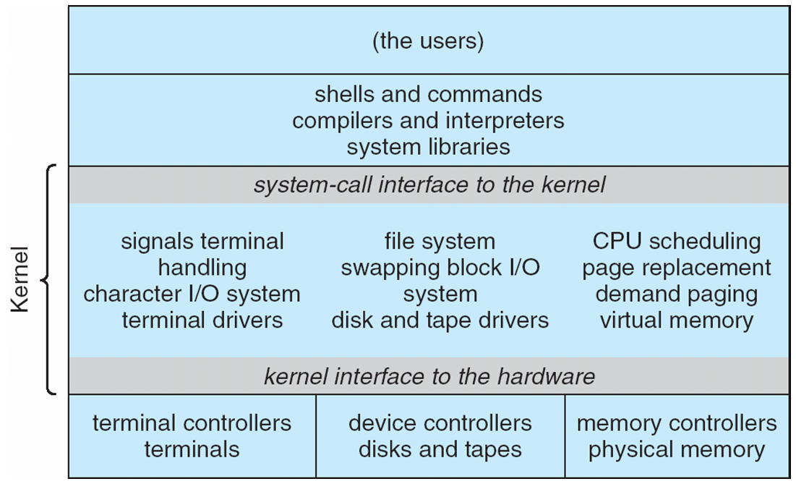
Traditional UNIX System Structure
Beyond simple but not fully layered

Slide 11
Microkernel System Structure

Slide 12
Process Concept
An operating system executes a variety of programs:
Batch system – jobs
Time-shared systems – user programs or tasks
Process – a program in execution; process execution must progress in sequential fashion
Multiple parts
The program code, also called text section
Current activity including program counter, processor registers
Stack containing temporary data
Function parameters, return addresses, local variables
Data section containing global variables
Heap containing memory dynamically allocated during run time

Slide 13
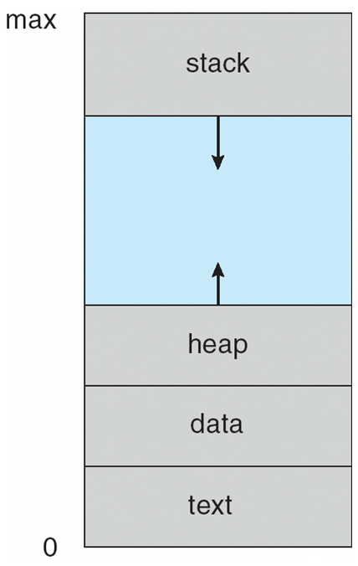
Process in Memory

Slide 14
Process State
As a process executes, it changes state
new: The process is being created
running: Instructions are being executed
waiting: The process is waiting for some event to occur
ready: The process is waiting to be assigned to a processor
terminated: The process has finished execution

Slide 15
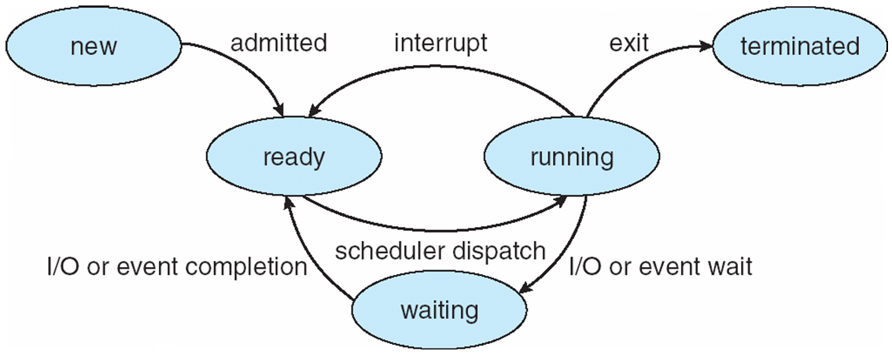
Diagram of Process State

Slide 16
Process Control Block
``Active entities are data structures when viewed from a lower level.’’
Raphael Finkel, University of Kentucky

Slide 17
Process Control Block (PCB)
Information associated with each process
(also called task control block)
Process state – running, waiting, etc
Program counter – location of instruction to execute next
CPU registers – contents of all process-centric registers
CPU scheduling information- priorities, scheduling queue pointers
Memory-management information – memory allocated to the process
Accounting information – CPU used, clock time elapsed since start, time limits
I/O status information – I/O devices allocated to process, list of open files

Slide 18
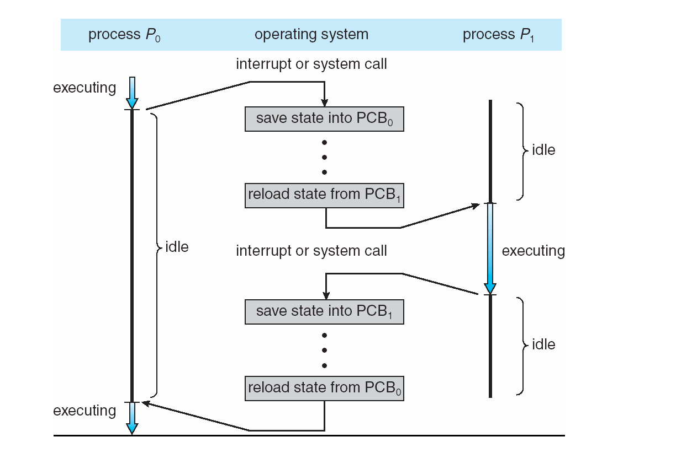
Context Switching

Slide 19
Context Switch
When CPU switches to another process, the system must save the state of the old process and load the saved state for the new process via a context switch
Context of a process represented in the PCB
Context-switch time is overhead; the system does no useful work while switching
The more complex the OS and the PCB ➔ the longer the context switch
Time dependent on hardware support
Some hardware provides multiple sets of registers per CPU ➔ multiple contexts loaded at once

Slide 20
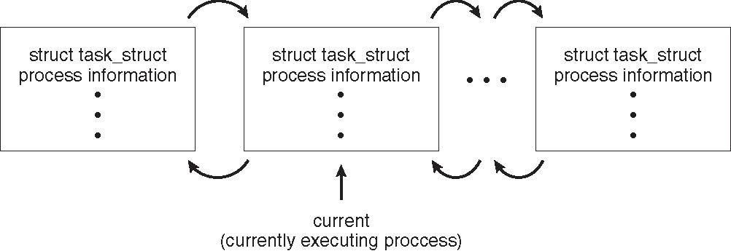
Process Representation in Linux
Represented by the C structure task_struct
pid t_pid; /* process identifier */ long state; /* state of the process */ unsigned int time_slice /* scheduling information */ struct task_struct *parent; /* this process’s parent */ struct list_head children; /* this process’s children */ struct files_struct *files; /* list of open files */ struct mm_struct *mm; /* address space of this process */

Slide 21
Xv6 Code Walkthrough
PCB and process table
context switching

Slide 22
So far …
Context Switching

Slide 23
Muddiest points
Xv6 code for context switching
Process lifecycle
CPU mode switching in context switching
What is inside PCB
Switching register sets in context switching
the code plus the diagram side by side
Determining when a context switch is actually required - if it's needed between each individual process regardless of user/kernel bit
monotlithic vs microkernel
Pros and cons
What a microkernel OS would look like in practice
the two tophat questions we all got wrong about immediately performing instructions in priviledged/non-priviledged mode
How long the context switching takes on average compared to the processes themselves.

Slide 24
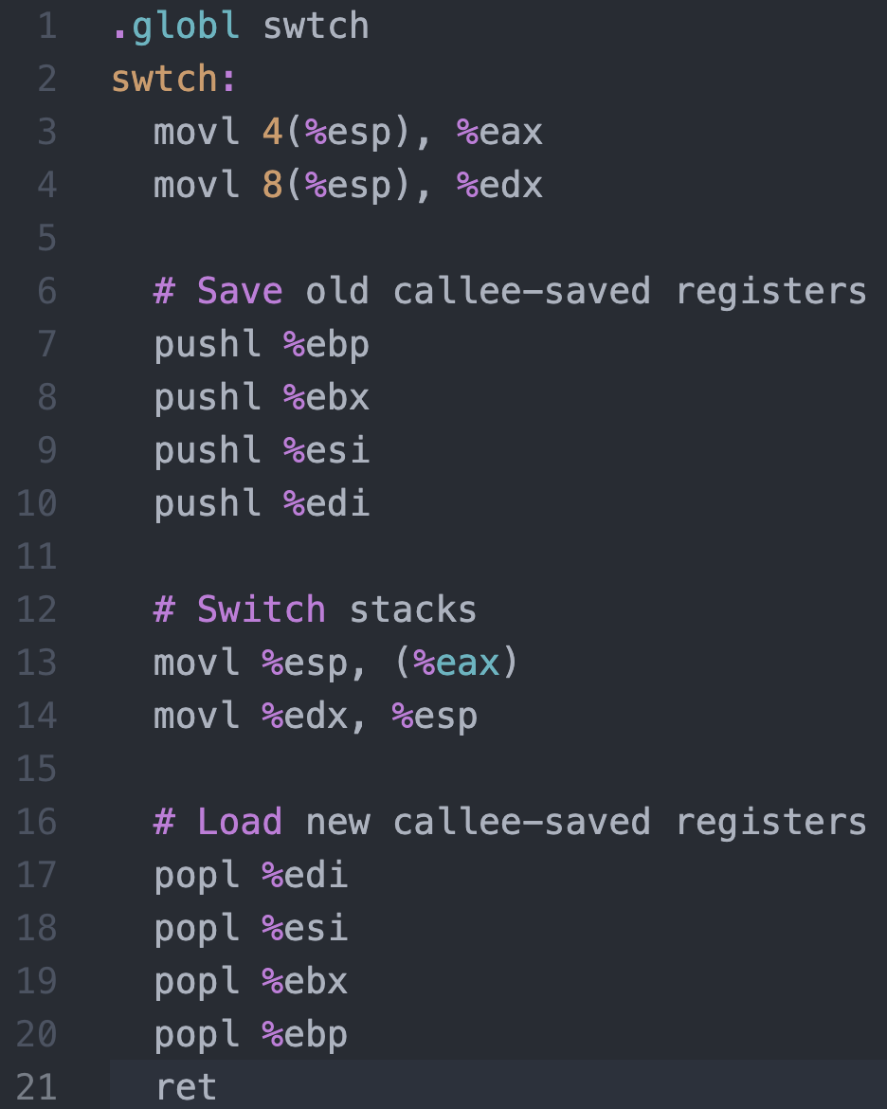
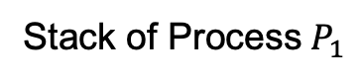
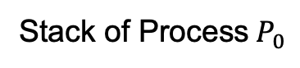
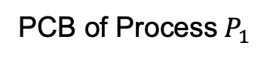
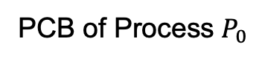
Context Switching in Xv6
%eax
%edx
context
Return address
PCB of Process${ P}_{0}$
%esp
%eip
Stack of Process${ P}_{0}$
Return address
Return address
CPU
context
PCB of Process${ P}_{1}$
Stack of Process${ P}_{1}$
Memory

Slide 25
Process Lifecycle

Slide 26
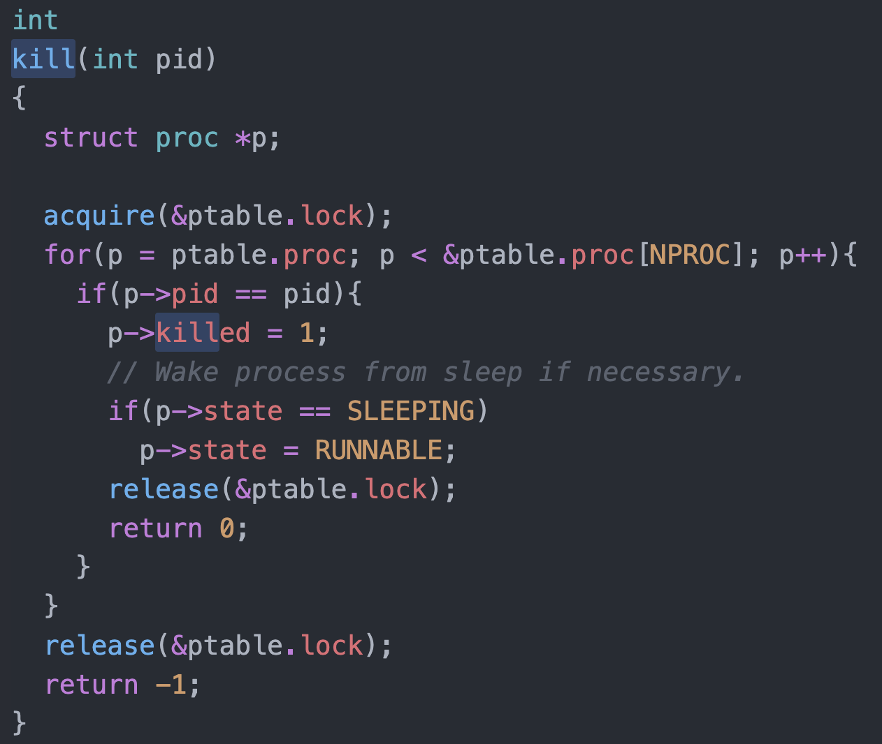
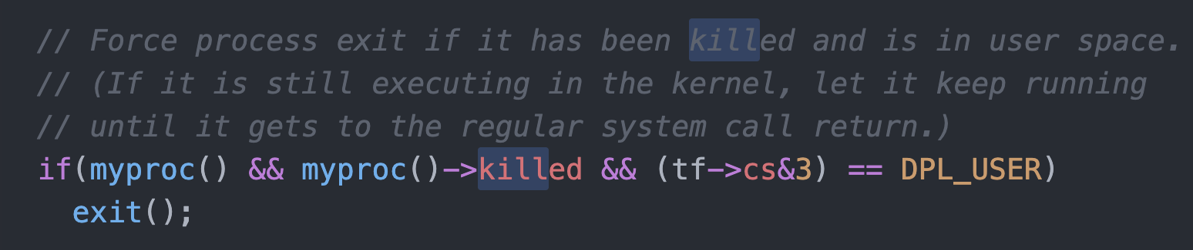
Killing a waiting process

Slide 27
Process Scheduling
Maximize CPU use, quickly switch processes onto CPU for time sharing
Process scheduler selects among available processes for next execution on CPU
Maintains scheduling queues of processes
Job queue – set of all processes in the system
Ready queue – set of all processes residing in main memory, ready and waiting to execute
Device queues – set of processes waiting for an I/O device
Processes migrate among the various queues

Slide 28
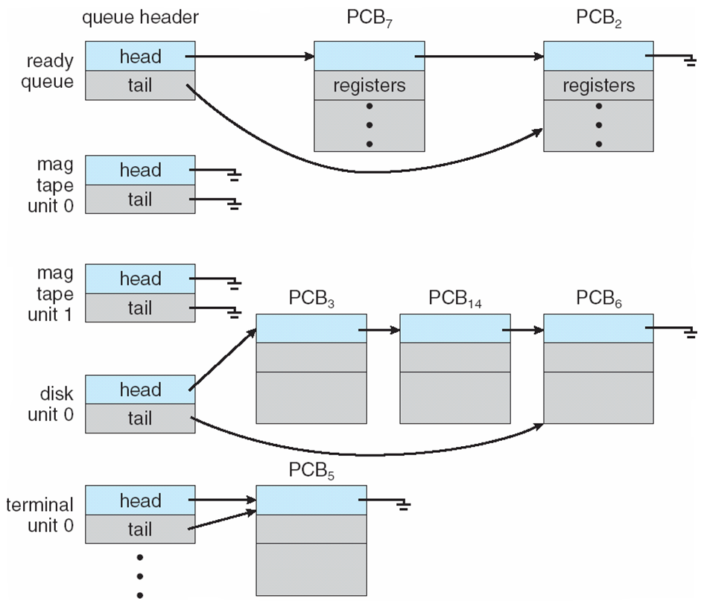
Ready Queue And Various I/O Device Queues

Slide 29
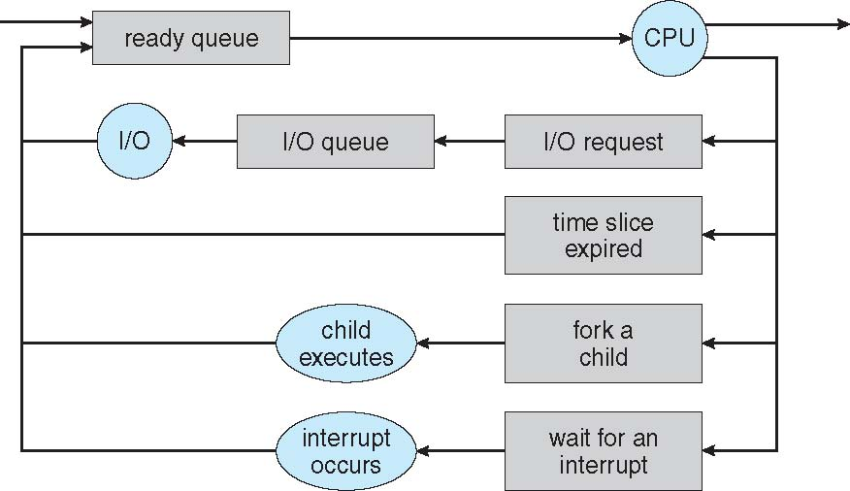
Representation of Process Scheduling
Queueing diagram represents queues, resources, flows

Slide 30
Schedulers
Short-term scheduler (or CPU scheduler) – selects which process should be executed next and allocates CPU
invoked frequently (milliseconds) ⇒ (must be fast)
Long-term scheduler (or job scheduler) – selects which processes should be brought into the ready queue
invoked infrequently (seconds, minutes) ⇒ (may be slow)
controls the degree of multiprogramming
Processes can be described as either:
I/O-bound process – spends more time doing I/O than computations, many short CPU bursts
CPU-bound process – spends more time doing computations; few very long CPU bursts
Long-term scheduler strives for good process mix

Slide 31
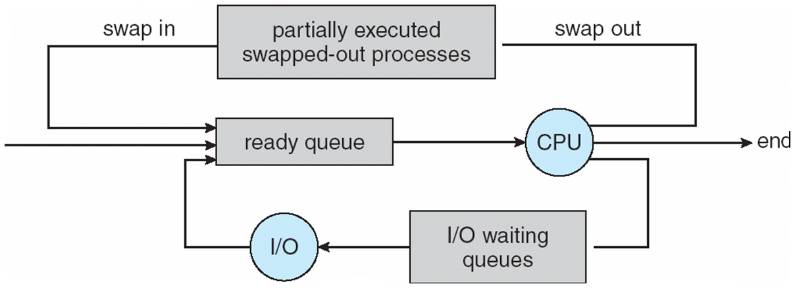
Addition of Medium Term Scheduling
Medium-term scheduler can be added if degree of multiple programming needs to decrease
Remove process from memory, store on disk, bring back in from disk to continue execution: swapping

Slide 32
Process Creation
Parent process creates children processes, which, in turn create other processes, forming a tree of processes
Generally, process identified and managed via a process identifier (pid)
Resource sharing options
Parent and children share all resources
Children share subset of parent’s resources
Parent and child share no resources
Execution options
Parent and children execute concurrently
Parent waits until children terminate

Slide 33
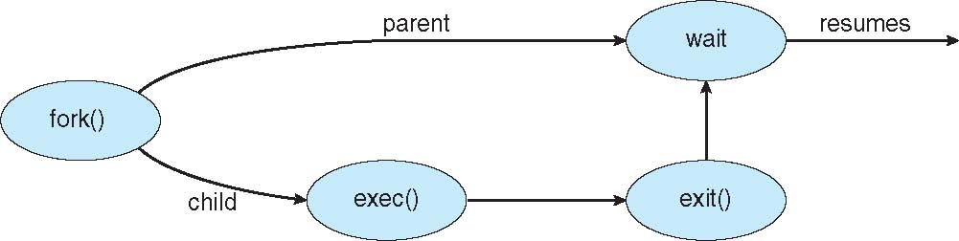
Process Creation (Cont.)
Address space
Child duplicate of parent
Child has a program loaded into it
UNIX examples
fork() system call creates new process
exec() system call used after a fork() to replace the process’ memory space with a new program

Slide 34
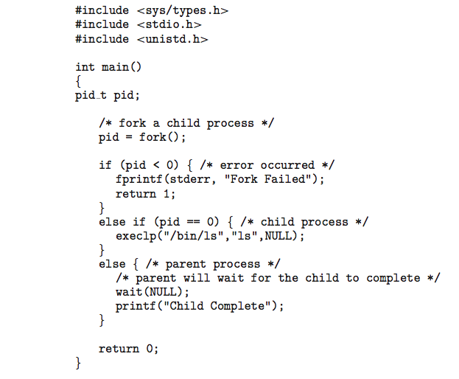
C Program Forking Separate Process

Slide 35
Process Termination
Process executes last statement and then asks the operating system to delete it using the exit() system call.
Returns status data from child to parent (via wait())
Process’ resources are deallocated by operating system
Parent may terminate the execution of children processes using the abort() system call. Some reasons for doing so:
Child has exceeded allocated resources
Task assigned to child is no longer required
The parent is exiting and the operating systems does not allow a child to continue if its parent terminates

Slide 36
Process Termination
Some operating systems do not allow a child to exist if its parent has terminated. If a process terminates, then all its children must also be terminated.
cascading termination. All children, grandchildren, etc. are terminated.
The termination is initiated by the operating system.
The parent process may wait for termination of a child process by using the wait()system call. The call returns status information and the pid of the terminated process
pid = wait(&status);
If no parent waiting (did not invoke wait()) process is a zombie
If parent terminated without invoking wait , process is an orphan

